Slide 1
DATA ANALYSIS ON FIFA-2019 DATASET

Slide 2
FEW STATISTICS OF THE DATA.
There are 164 different countries in the given dataset.
There are 651 unique clubs in the given dataset.
There are 17194 players in the given dataset.
There are 134 players in the dataset who are rated 975,which is the highest rating for a player.
The oldest player in the dataset is O. Pérez 45,plays for pachua,and is from Mexico.
There are 42 youngest players who are aged 16.

Slide 3

Overall Rating-94
Potential-94
Nationality-Argentina
Club-Barcelona
Preferred foot-Left
Age-31
Jersey number-10
Position-RF
No.1 Player according to the given statistics.

Slide 4
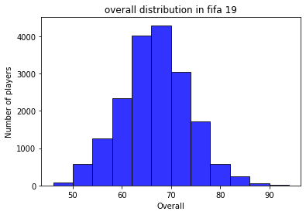
OVERALL RATING
Here the graph is between the overall rating
and number of players.
we can clearly see that most of the players
are having the overall rating between 62-70
approximately.

Slide 5
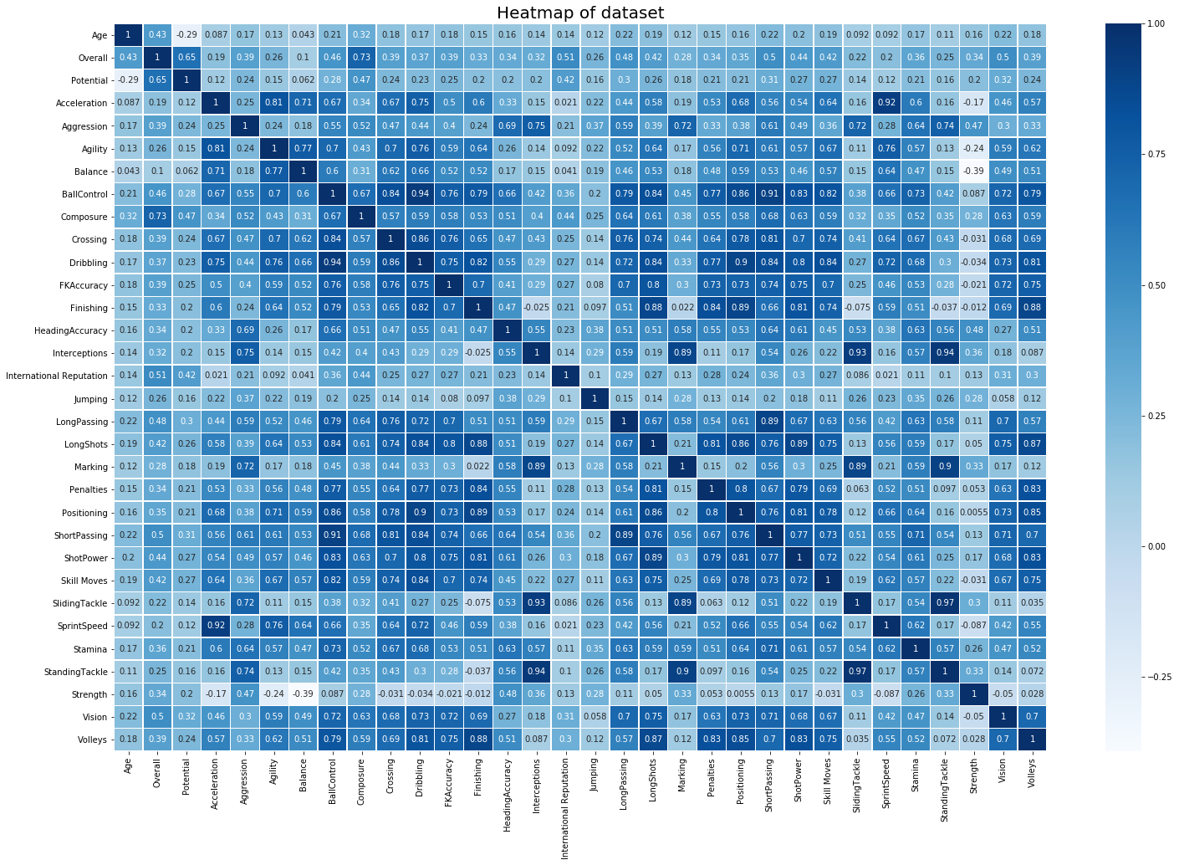
Correlation between the features.

Slide 6
There are 27 unique positions given in the dataset.
And we have sorted each position according to the overall rating given to the player,So that it will be easy to select best team.
In order to have perfect player in all the positions we have selected the top rated players according to the positions.
The only task is to set the budget and select the players for the best team to have perfect game.

